Slide 1
ANALYSIS OF GDP PER CAPITA
AND
LIFE EXPECTANCY
LEE LING JUN

Slide 2
CONTENT
INTRODUCTION
EXPLORATORY DATA ANALYSIS
Background motivation
Research Question & Objectives
Analysis Scope
Descriptive Statistics
Missing Data
Data Quality
ANALYSIS & FINDINGS
DATASET OVERVIEW
Trends Income and Longevity
Cross-Sectional Relationship Between GDP and Life Expectancy
Life Expectancy Differences Across Income Groups
Regression and Outliers in GDP – Life Expectancy
Dataset Source & Accessibilities
Key Variables and Structure
PRE-PROCESSING
CONCLUSION
Merging data sets
Cleaning and Transformation of variables.
Handling Missing values and outliers.
Engineered Features
Summary of findings.
Implications for Global Development
Limitations of the Analysis
Recommendations

Slide 3

BACKGROUND & MOTIVATION
BROAD RISE IN ECONOMIC DEVELOPMENT AND HEALTH
Over the past two centuries, both economic development and population health have increased.
Higher economic development generally improves quality of life and supports longer life expectancy.
VARIATION DESPITE OVERALL GROWTH
Significant differences persist: some high-income countries show only modest health outcomes, while some middle-income countries achieve unexpectedly high longevity.
This motivates examining how closely economic prosperity and life expectancy actually move together.
Introduction

Slide 4
RESEARCH QUESTION & OBJECTIVES
Describe long-run global trends in both GDP per capita and life expectancy.
Examine the cross-sectional relationship in recent years, including whether log-transforming GDP clarifies the association.
Compare outcomes across income groups and identify countries that perform better or worse than expected given their income level.
Introduction

Slide 5
01
GDP per Capita
The Maddison Project Database, which has estimates of GDP per capita in constant international dollars over several centuries, The dataset can be downloaded by the general public through Our World in Data at
https://ourworldindata.org/grapher/gdp-per-capita-maddison-project-database
Dataset Overview
02
Life Expectancy
Life expectancy data: are drawn from an Our World in Data dataset containing period life expectancy estimates at multiple ages (0, 10, 15, 25, 45, 65 and 80) by country and year
https://ourworldindata.org/grapher/life-expectancy-hmd-unwpp?country=FRA~ZAF~NGA~CHN
Dataset Overview

Slide 6
Feature | Description
Year | Calendar year of measurement. Dataset is annual time-series.
Entity | Country or region name (e.g. Afghanistan, Spain, United Kingdom).
Code | ISO-3 country code used to uniquely identify each Entity.
Year | Calendar year of measurement. Dataset is annual time-series.
GDP per capita | Gross Domestic Product per person, measured in constant international dollars. This represents economic output adjusted for population size and inflation, making it comparable across countries and over time.
900793-annotations | Auxiliary metadata column (mostly empty). Contains annotation flags used internally by the source organisation. Not used for modelling or analysis.
GDP per capita
DATASET OVERVIEW

Slide 7
Feature | Description
Entity | Country or region name (e.g. Afghanistan)
Code | ISO-3 country code
Year | Calendar year of observation
Life expectancy variables (7 columns) | Period life expectancy measures at ages 0, 10, 15, 25, 45, 65, 80 — expected remaining years of life at each age, averaged across sexes
Life Expectancy
Dataset Overview

Slide 8

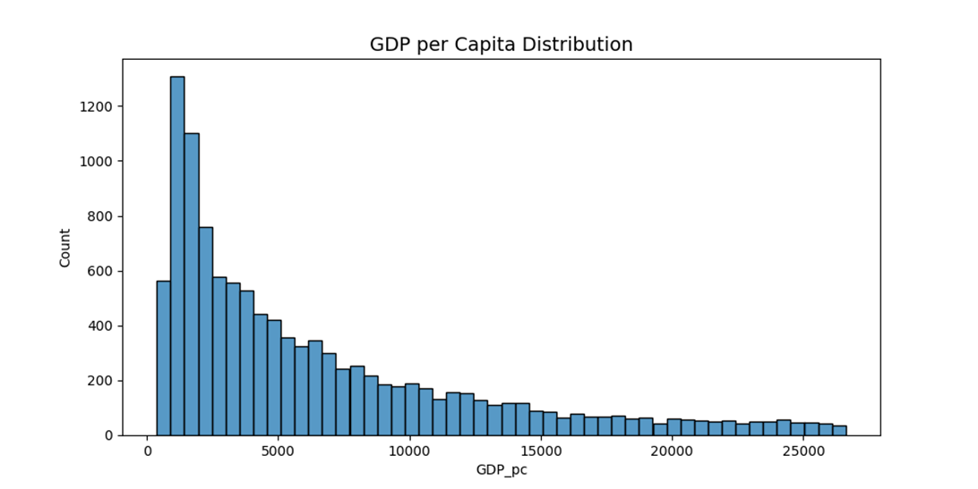
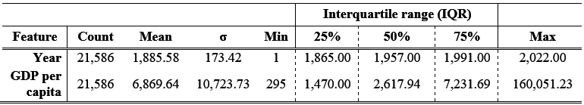
Descriptive Statistics:
GDP per Capita

Slide 9
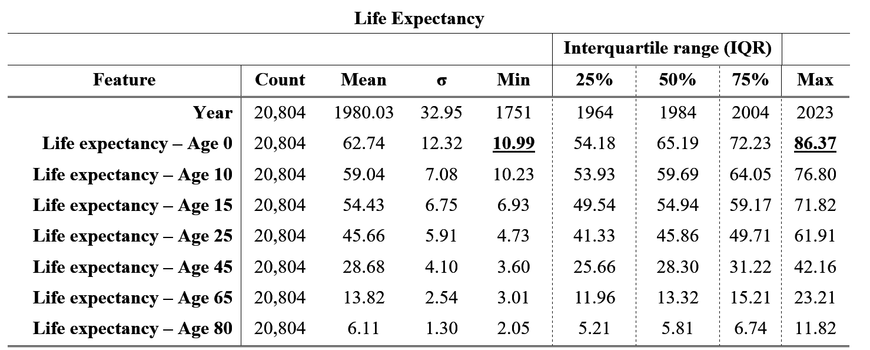
Descriptive Statistics:
Life Expectancy

Slide 10
Missingness:
GDP per capita dataset
Features | Missingness (%)
900793-annotations | 9.987
Code | 1.26
Entity | 0
Year | 0
GDP per Capita | 0
Life Expectancy Dataset
Features | Missingness (%)
Code | 9.3
Entity | 0
Year | 0
Age: 0 | 0
Age: 10 | 0
Age: 15 | 0
Age: 25 | 0
Age: 45 | 0
Age: 65 | 0
Age: 80 | 0

Slide 11
Merging Data Sets
PREPROCESSING
CONSISTENT MATCHING
CLEAN ALIGNED PANEL STRUCTURE
An inner join on Entity, Code, and Year was applied to retain only observations that appear in both datasets.
This prevents artificial gaps that would occur if unmatched country–year entries were kept.
The resulting dataset contains coherent country–year rows where GDP per capita and all life-expectancy measures refer to the same observation.
This alignment ensures comparability and reliability for subsequent analysis.

Slide 12
Cleaning and Transformation
PREPROCESSING
STANDARDISATION
HARMONISING DATA
NON ESSENTIAL
Long descriptive labels (e.g., “Life expectancy – Sex: total – Age: 0 – Type: period”) were shortened to clear codes like LE_0, LE_10, … LE_80, and GDP per capita was renamed to GDP_pc to simplify coding and interpretation.
The Year variable was cast to integer, and all numeric fields were converted to proper numeric types, with invalid entries coerced to missing to prevent processing errors
Irrelevant annotation or metadata columns were dropped so that only variables directly needed for analysis and visualisation remained, reducing clutter and improving clarity.

Slide 13
Handling Missing values and outliers
PREPROCESSING
MISSING DATA
IRRELEVANT
OUTLIER
Columns that added no analytical value (e.g., duplicate life-expectancy measures, unused GDP variants) were removed to avoid noise in the analysis.
Small gaps in country time series were imputed using forward/backward fills to preserve each nation’s historical trend rather than introduce artificial jumps
Outliers were filtered using the IQR method to reduce distortion and ensure that extreme values did not disproportionately influence the results.

Slide 14
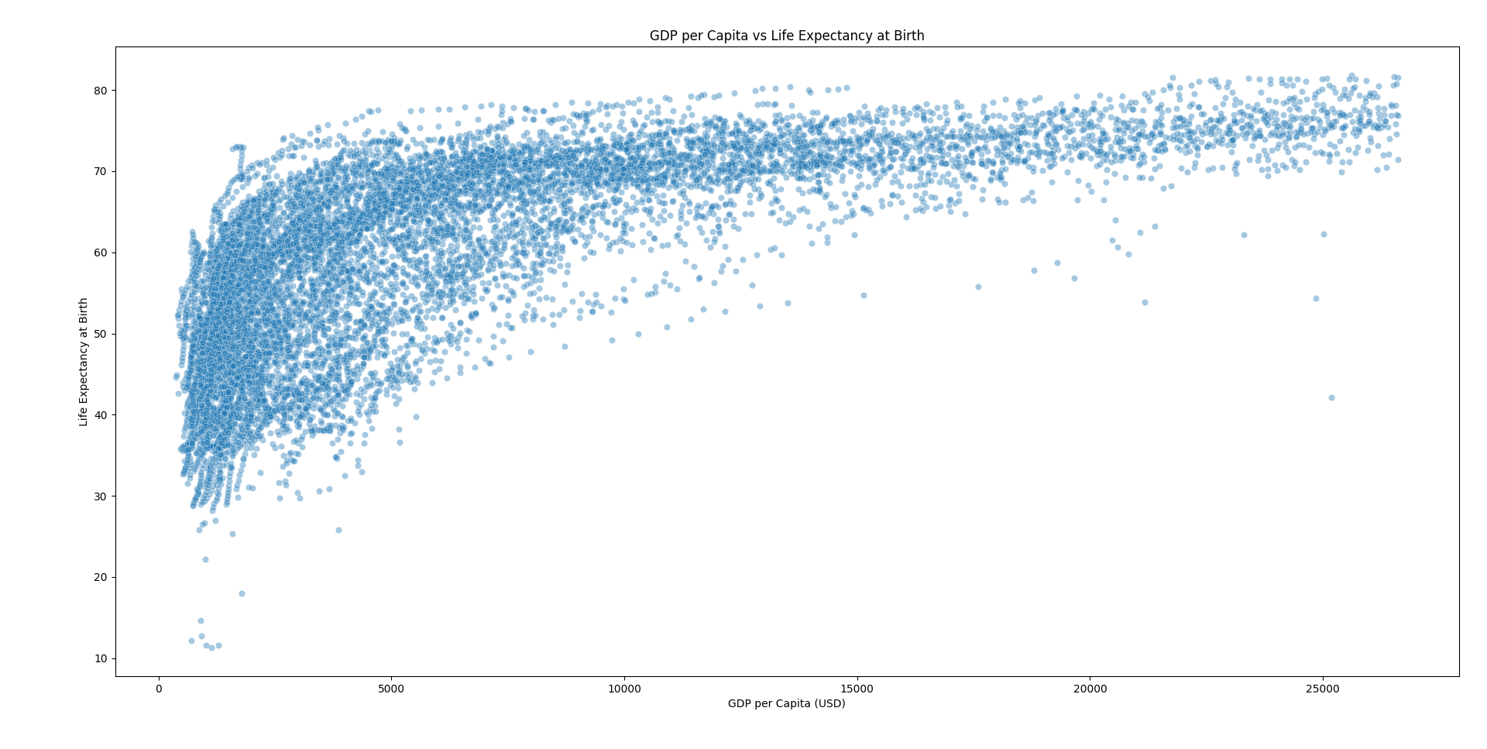
Engineered Features
PREPROCESSING

Slide 15
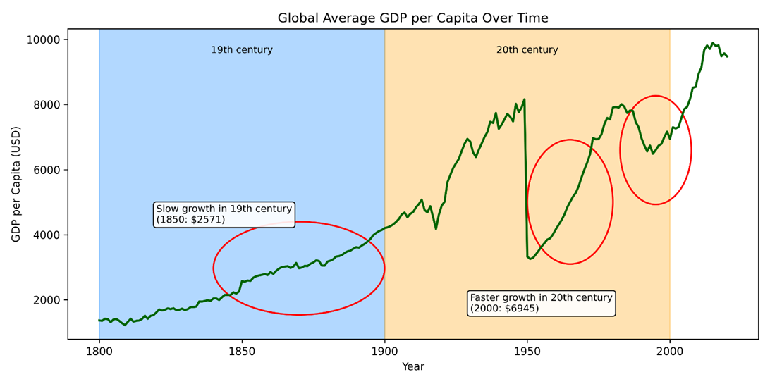
VISUAL ANALYSIS
Trends

Slide 16
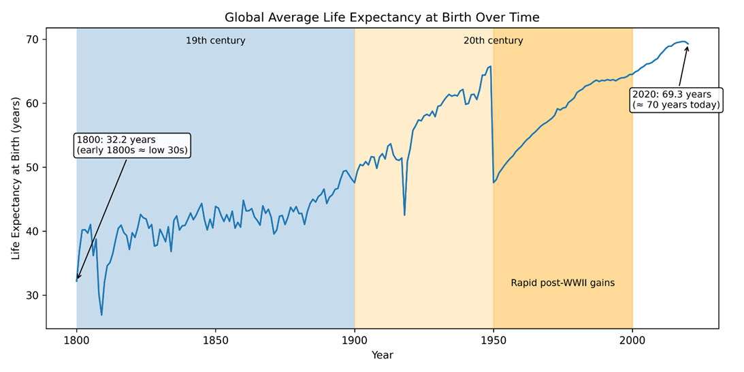
VISUAL ANALYSIS
Trends

Slide 17
Cross-Sectional Relationship:
Correlation Decade Mean
VISUAL ANALYSIS
 | GDP_pc | LE_0 | LE_mean
GDP_pc | 1 | 0.985467 | 0.985671
LE_0 | 0.985467 | 1 | 0.997781
LE_mean | 0.985671 | 0.997781 | 1
Very high correlations (>0.98) across all variables.
GDP and life expectancy move closely together when averaged by decade.
LE_0 and LE_mean almost identical (≈0.998 correlation).
Smoothing removes noise → reveals strong long-run co-movement.
Shows stable global progress in both income and longevity over decades.
Legend
GDP_pc | Raw GDP per capita
LE_0 | Life Expectancy at birth
LE_mean | Mean Life Expectancy across all ages

Slide 18
Cross-Sectional Relationship:
Correlation Pearson
VISUAL ANALYSIS
GDP and LE₀ are strongly linked
Moderate–strong positive correlation (~0.70).
Richer countries generally live longer.
Log(GDP) fits the relationship better
log_GDP_pc correlates more strongly with LE₀ (~0.78).
Supports diminishing returns to income.
Life expectancy measures move together
LE₀ and LE_mean correlate extremely highly (~0.98).
Better infant survival → better longevity at all ages.
GDP variables correlate by design
GDP_pc and log_GDP_pc ~0.90.
Log is a scaling transformation of the same variable.
Correlation ≠ causation
Income helps, but health systems, education, and stability also matter.
 | GDP_pc | log_GDP_pc | LE_0 | LE_mean
GDP_pc | 1 | 0.902949 | 0.699438 | 0.714579
log_GDP_pc | 0.902949 | 1 | 0.77806 | 0.772722
LE_0 | 0.699438 | 0.77806 | 1 | 0.980876
LE_mean | 0.714579 | 0.772722 | 0.980876 | 1
Legend
GDP_pc | Raw GDP per capita
log_GDP_pc | Natural Log of GDP per Capita
LE_0 | Life Expectancy at birth
LE_mean | Mean Life Expectancy across all ages

Slide 19
Cross-Sectional Relationship:
Correlation Spearmen
VISUAL ANALYSIS
1. Strong monotonic link
Higher-income countries consistently rank higher in life expectancy. (~0.80).
2. Log(GDP) aligns well:
log_GDP_pc–LE₀ correlation is identical (~0.80).
Reinforces that relative income differences track life expectancy well.
3. Life expectancy measures move together
LE₀ ≈ LE_mean (≈0.99).
4. GDP variables rank identically:
GDP_pc & log_GDP_pc have perfect monotonic correlation (=1).
Log transform changes scale, not ordering.
5. Spearman confirms robustness
Not driven by outliers; trend holds in ranks.
 | GDP_pc | log_GDP_pc | LE_0 | LE_mean
GDP_pc | 1 | 1 | 0.804817 | 0.790763
log_GDP_pc | 1 | 1 | 0.804817 | 0.790763
LE_0 | 0.804817 | 0.804817 | 1 | 0.990084
LE_mean | 0.790763 | 0.790763 | 0.990084 | 1
Legend
GDP_pc | Raw GDP per capita
log_GDP_pc | Natural Log of GDP per Capita
LE_0 | Life Expectancy at birth
LE_mean | Mean Life Expectancy across all ages

Slide 20
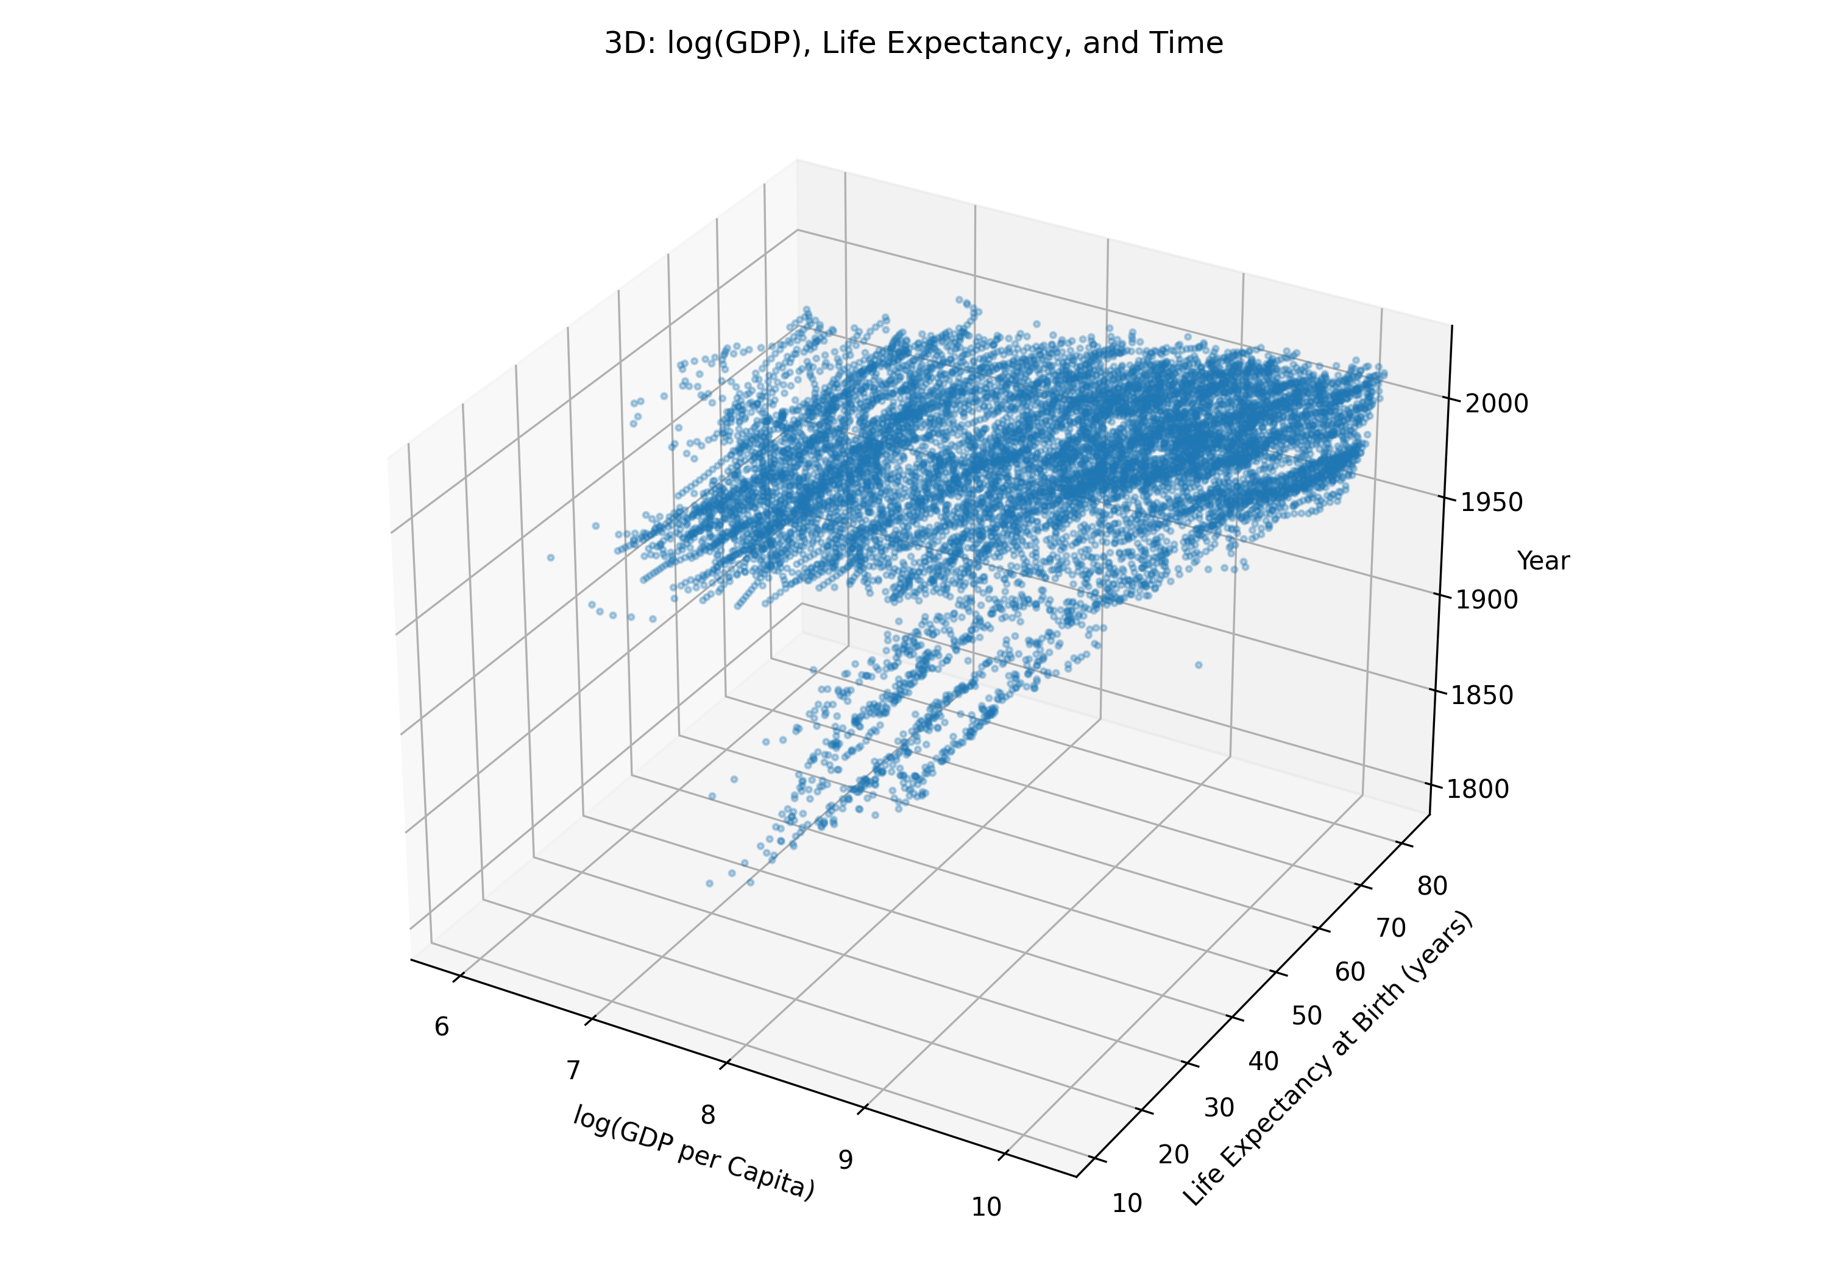
Cross-Sectional Relationship:
VISUAL ANALYSIS

Slide 21
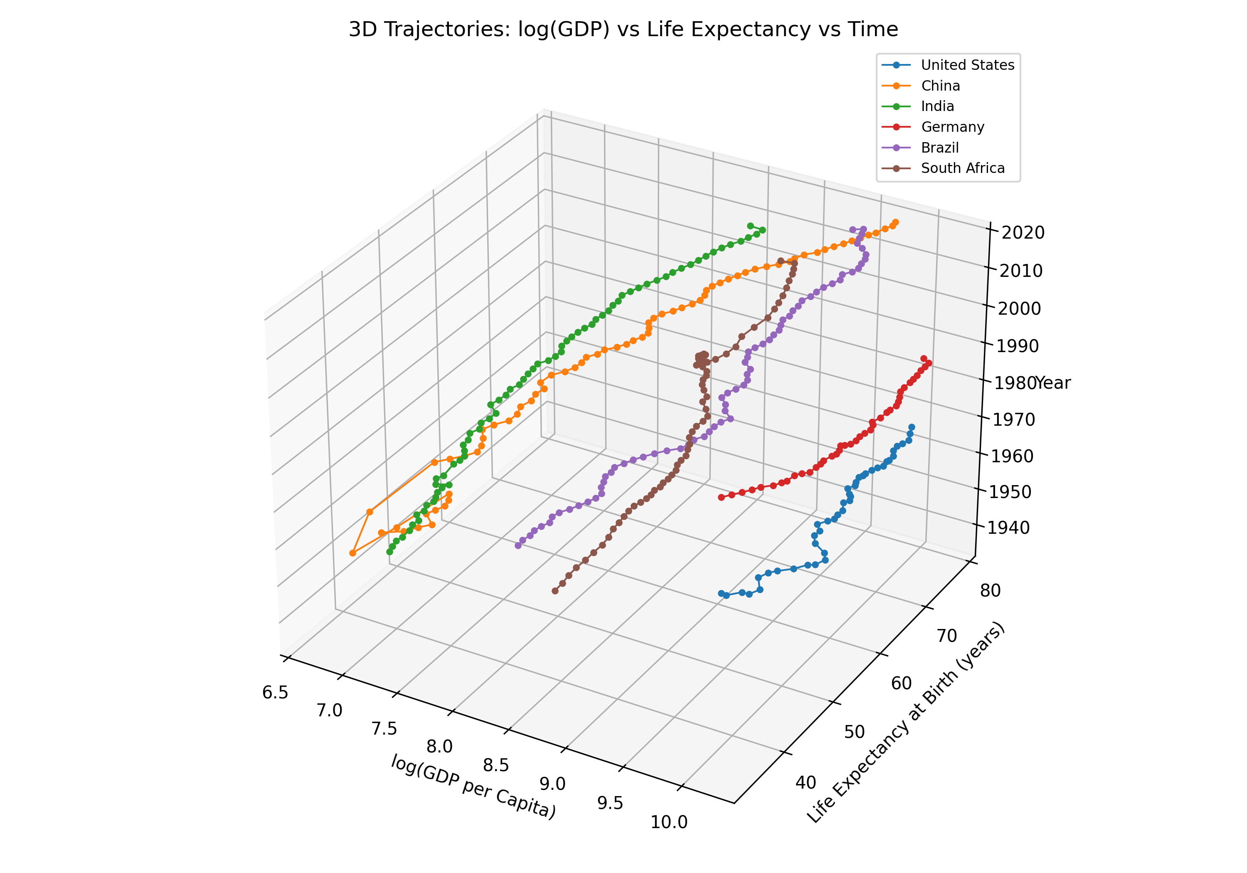
Cross-Sectional Relationship:
VISUAL ANALYSIS

Slide 22
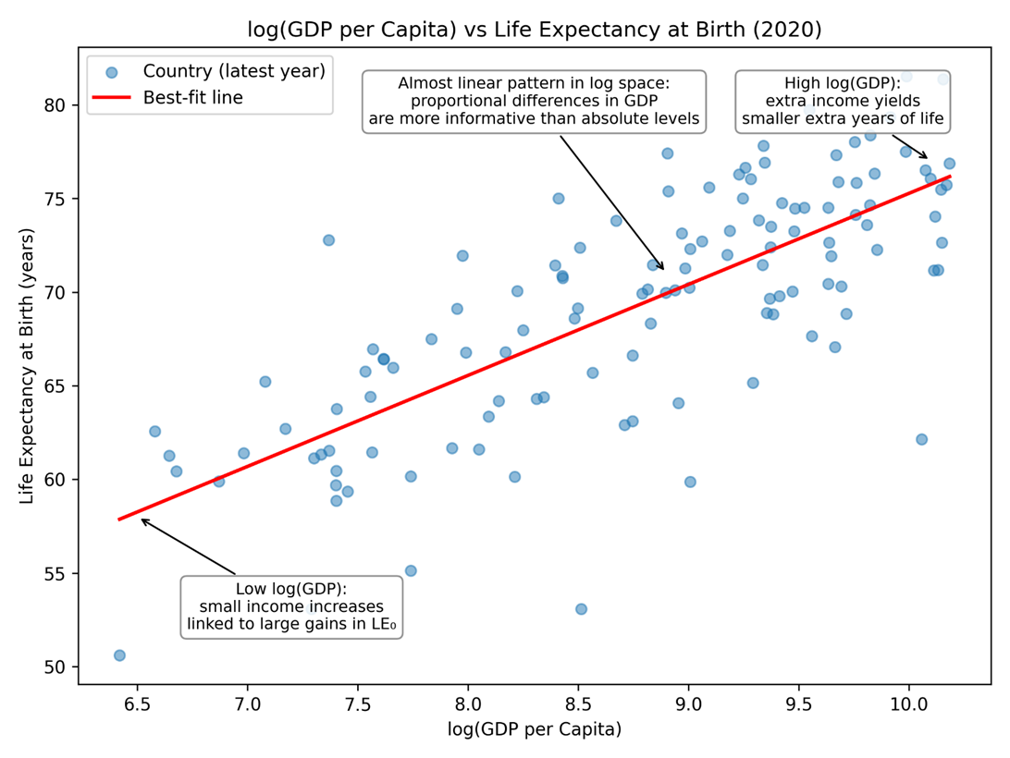
Cross-Sectional Relationship:
VISUAL ANALYSIS

Slide 23
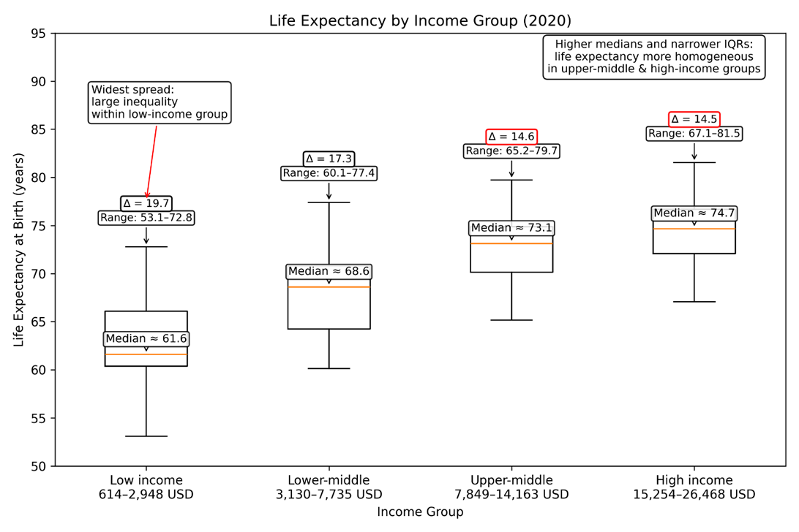
Cross-Sectional Relationship:
VISUAL ANALYSIS

Slide 24
Cross-Sectional Relationship:
VISUAL ANALYSIS

Slide 25
Summary of findings
CONCLUSION
LONG-RUN GLOBAL TRNEDS
Life expectancy: slow 19th-century rise → sharp 20th-century jump.
GDP per capita: gradual early growth → rapid mid-20th-century increase.
Both rise together over time.
NON-LINEAR RELATIONSHIP
Positive but non-linear link.
Low-income: big health gains from small GDP increases.
High-income: small health gains despite large GDP growth.
INCOME GROUP DIFFERENCES
Low-income: lowest medians, widest spread → unequal health access.
Upper-middle/high-income: higher medians, narrow spread → more uniform conditions.

Slide 26
Limitation of Analysis
CONCLUSION
Historical data, especially before the 20th century, rely on reconstructed estimates and may be incomplete or inaccurate.
GDP per capita and life expectancy capture only broad trends and exclude deeper dimensions of wellbeing such as inequality, morbidity, and quality of life.
The analysis is descriptive and does not account for underlying drivers (e.g., education, health systems).
Income-group classifications simplify a complex reality, as similar GDP levels can mask very different health outcomes.

Slide 27
THANKYOU

